Slide 1

Mammographic Prediction with BI-RADS Assessments
Milestone Project 3
Wisconsin Data Science and Analytics
Donald Taggart
January 15, 2023

Slide 2
Mammographic Prediction with BI-RADS Assessments
Milestone Project 3
Wisconsin Data Science and Analytics
Donald Taggart
January 15, 2023

Slide 3
“The” Conversation
“The” Conversation
Dataset
Question
Background
Data
EDA
Modeling
Results
Conclusion
The ultrasound data predicted that you had a 96.58% probability of having malignant breast cancer and the biopsy confirmed it.
That’s an awful specific number Doc. How on earth did you arrive at that?
We take measurements during the ultrasound and use a statistical model with a more than 98% accuracy to predict the probability that a tumor is malignant. Basically, if the model says you have cancer, you have cancer.

Slide 4
Dataset
“The” Conversation
Dataset
Question
Background
Data
EDA
Modeling
Results
Conclusion
Mammographic Mass Data Set
M. Elter, R. Schulz-Wendtland and T. Wittenberg (2007)
The prediction of breast cancer biopsy outcomes using two CAD approaches that both emphasize an intelligible decision process.
Medical Physics 34(11), pp. 4164-4172
UCI Machine Learning Repository
Dataset
Abstract
Data Dictionary

Slide 5
Question
“The” Conversation
Dataset
Question
Background
Data
EDA
Modeling
Results
Conclusion
“Mammography is the most effective method for breast cancer screening available today. However, the low positive predictive value of breast biopsy resulting from mammogram interpretation leads to approximately 70% unnecessary biopsies with benign outcomes.”
Can you improve upon the 30% precision by applying a machine learning model to BI-RADS assessment data and reduce the number of unnecessary breast biopsies?

Slide 6
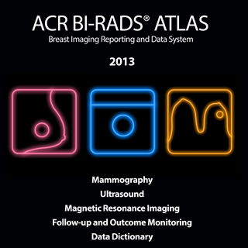
Background
“The” Conversation
Dataset
Question
Background
Data
EDA
Modeling
Results
Conclusion
Breast Imaging Reporting and Data System (BI-RADS)
Project started in the late 1980s
American College of Radiologists
Goal to develop a common lexicon
Updated several times
Covers the areas of
Mammography
Ultrasound
MRI

Slide 7
Background
“The” Conversation
Dataset
Question
Background
Data
EDA
Modeling
Results
Conclusion
BI-RADS Assessment Categories
0 – Inconclusive
1 – Negative
2 – Benign
3 – Probably Benign (< 2%)
4 – Suspicious (50 – 95%)
5 – Highly Suggestive (> 95%)
6 – Known Biopsy-proven

Slide 8
Data
“The” Conversation
Dataset
Question
Background
Data
EDA
Modeling
Results
Conclusion
“This dataset can be used to predict the severity (benign or malignant) of a mammographic mass lesion from BI-RADS attributes and the patient's age.”
BI-RADS Assessment (non-predictive)
Patient’s Age
Three BI-RADS Attributes
Shape
Margin
Density
Ground Truth
516 Benign
445 Malignant
Institute of Radiology of the University Erlangen-Nuremberg between 2003 and 2006

Slide 9
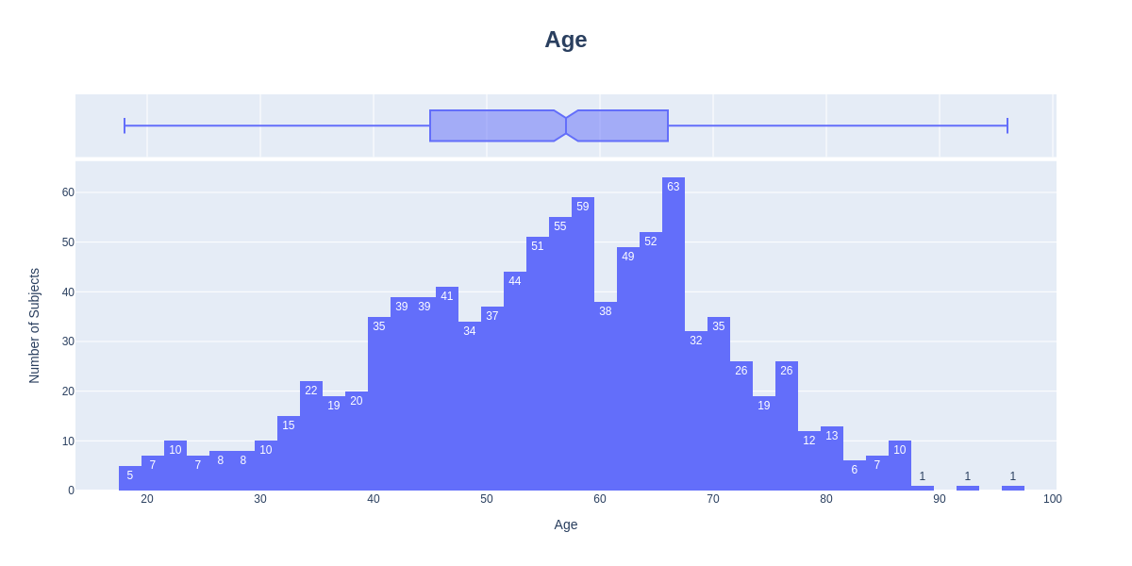
“The” Conversation
Dataset
Question
Background
Data
EDA
Modeling
Results
Conclusion
Count | 956
Mean | 55.49
Std | 14.48
Min | 18
25% | 45
50% | 57
75% | 66
Max | 96
Data Wrangling
Type: Integer
Null Values: 5 imputed to the mean
Standardized

Slide 10
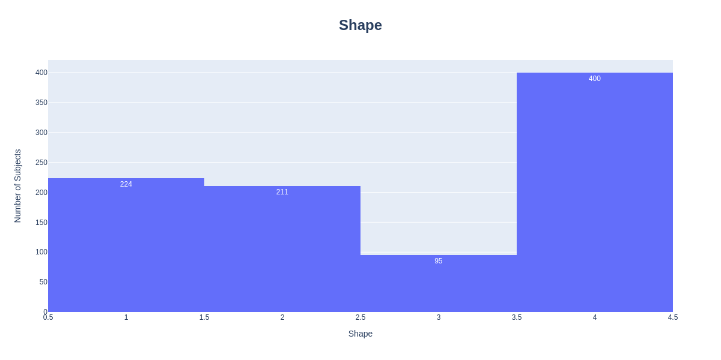
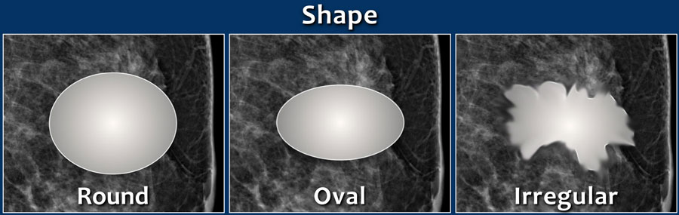
“The” Conversation
Dataset
Question
Background
Data
EDA
Modeling
Results
Conclusion
Round
Oval
Lobular
Irregular
Data Wrangling
Type: Nominal
Null Values: 31
One-hot encoded
Radiology Assistant: Accessed 1-13-2023

Slide 11
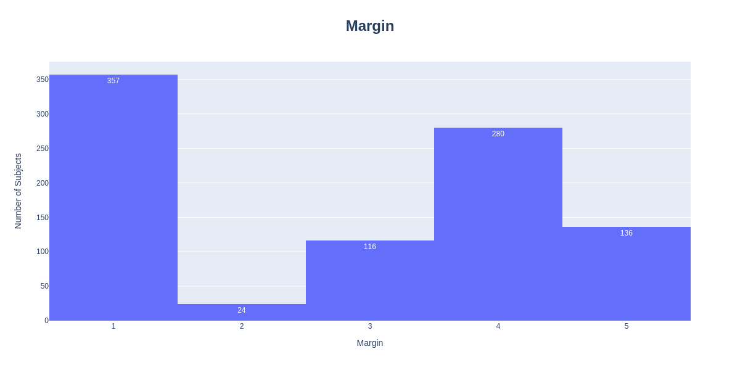
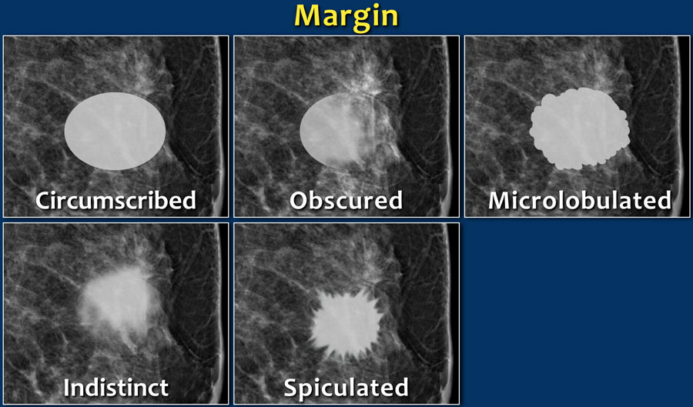
“The” Conversation
Dataset
Question
Background
Data
EDA
Modeling
Results
Conclusion
Circumscribed
Microlobulated
Obscured
Indistinct
Spiculated
Data Wrangling
Type: Nominal
Null Values: 48
One-hot encoded
Radiology Assistant: Accessed 1-13-2023

Slide 12
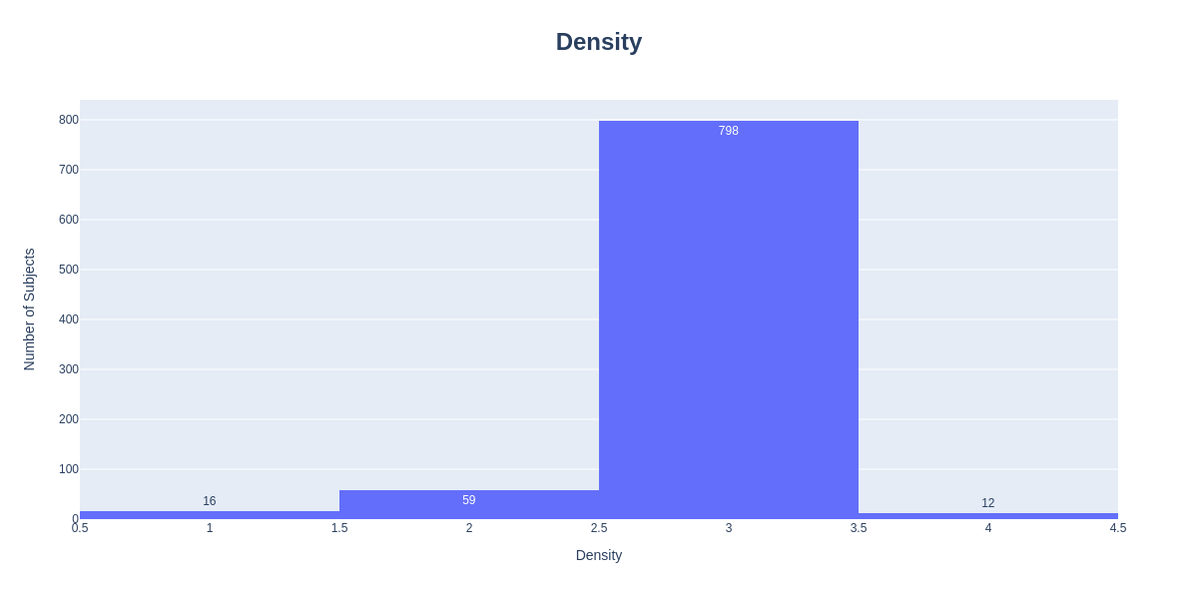
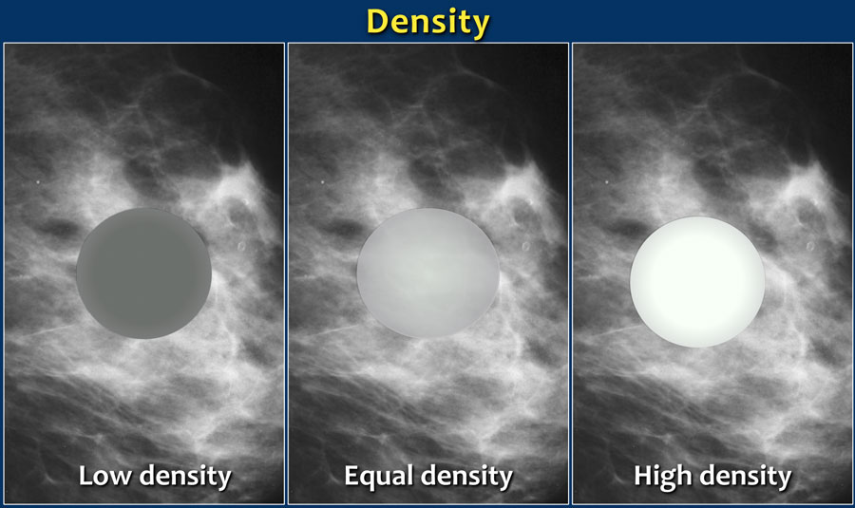
Density
“The” Conversation
Dataset
Question
Background
Data
EDA
Modeling
Results
Conclusion
High
Equal
Low
Fat-containing
Data Wrangling
Type: Ordinal
Null Values: 76 imputed to the mean
Standardized
Radiology Assistant: Accessed 1-13-2023

Slide 13
Modeling
“The” Conversation
Dataset
Question
Background
Data
EDA
Modeling
Results
Conclusion
Binary classification problem
Models tested
Logistic Regression
K-Nearest Neighbors
Support Vector Machine
Decision Tree
Random Forest
AdaBoost
Gradient Boost
Train-Test split
75% / 25%
Stratified
Tuning
GridSearchCV hyperparameter tuning
10-fold cross validation

Slide 14
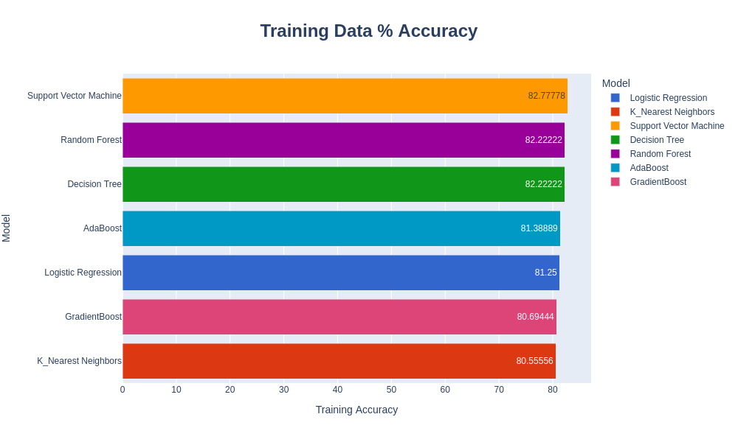
Results
“The” Conversation
Dataset
Question
Background
Data
EDA
Modeling
Results
Conclusion

Slide 15
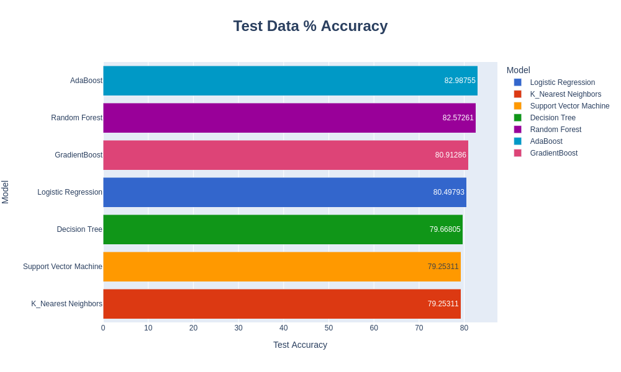
Results
“The” Conversation
Dataset
Question
Background
Data
EDA
Modeling
Results
Conclusion

Slide 16
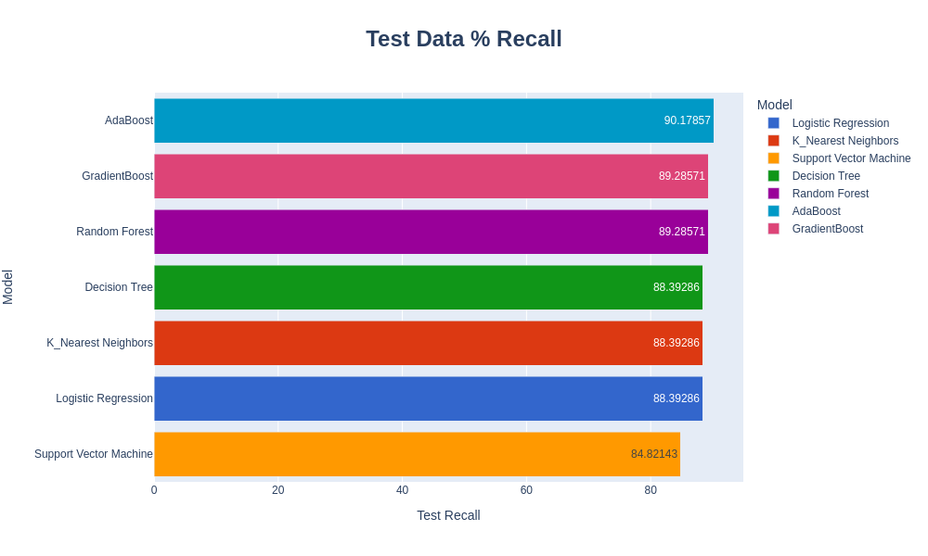
Results
“The” Conversation
Dataset
Question
Background
Data
EDA
Modeling
Results
Conclusion

Slide 17
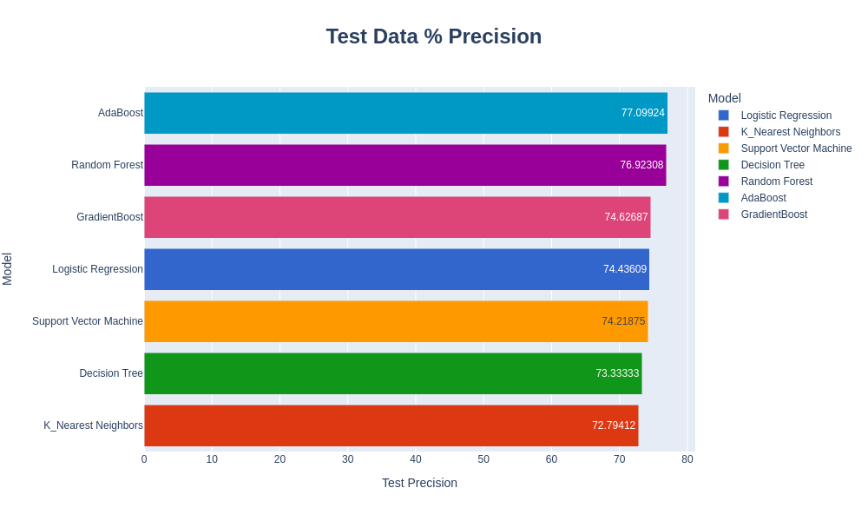
Results
“The” Conversation
Dataset
Question
Background
Data
EDA
Modeling
Results
Conclusion

Slide 18
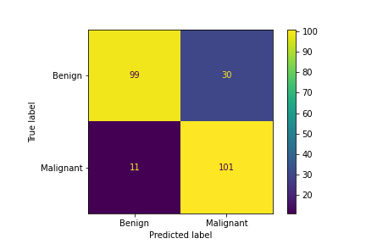
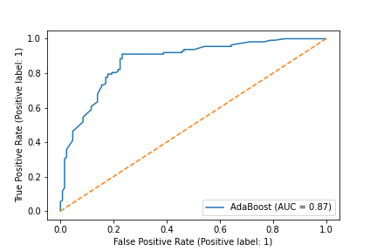
Results
“The” Conversation
Dataset
Question
Background
Data
EDA
Modeling
Results
Conclusion
Model | AdaBoost
Accuracy | 83.0%
Recall | 90.2%
Precision | 77.1%
AUC | 0.87

Slide 19
Conclusion
“The” Conversation
Dataset
Question
Background
Data
EDA
Modeling
Results
Conclusion
Can you improve upon the 30% precision by applying a machine learning model to BI-RADS assessment data and reduce the number of unnecessary breast biopsies?
Yes! By applying an AdaBoost machine learning model to BI-RADS assessment data, you can achieve a 77% precision with a 90% recall.

Slide 20
Final Note
“The” Conversation
Dataset
Question
Background
Data
EDA
Modeling
Results
Conclusion
92% 5-year survival probability
We are 4.5 years in, and all is well.

